Slide 1

How does Internet work?

Slide 2

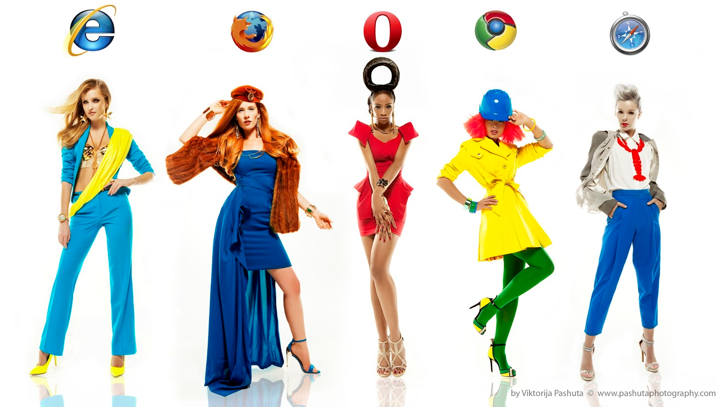
What is browser/user agent?

Slide 3

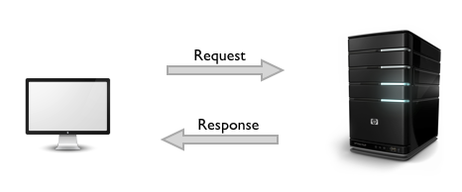
What happens when you type url address in your browser?
How your request flows?
What are headers?
What is http protocol?
What is server?

Slide 4
Differences between client side and server side
What is server side?
What is client side? What in fact is html/javascript/css?

Slide 5
Q & A

